Slide 1
Traffic Status and Insights
Submitted by: Naman Kapoor

Slide 2
Problem Statement
The organization deals with large volumes of website traffic data distributed across multiple tables and years. Analyzing this data manually to understand year-over-year growth, monthly trends, and overall performance is time-consuming and prone to errors. Existing reports primarily present raw numbers, which makes it difficult for management to quickly identify growth direction, performance health, and actionable insights. Additionally, limited access to GA4 APIs restricts real-time data extraction, further increasing dependency on manual data handling.

Slide 3
Proposed Solutions
Build an automated traffic analysis pipeline that:
Processes historical traffic data.
Calculates key metrics (YOY, LM, Total)
Generates management-level insights
Deliver output through:
A formatted Excel report for sharing
An interactive dashboard for quick exploration
Use an agent-based architecture for scalability and clarity.

Slide 4
System Architecture
Input
Agent
Metrics
Agent
Insight
Agent
Output
Agent
Agent Responsibilities
Input Agent: Reads and Validates traffic data.
Metrics Agent: Calculates YoY, MoM, totals
Insight Agent: Interprets overall growth trends.
Output Agent: Generates Excel report and charts.
Technology Used
Python, Pandas
LangGraph (agent orchestration)
Matplotlib (graphs)
Streamlit (dashboard)

Slide 5
Input and Output
Input
Excel file contains:
Month-wise traffic data.
Multiple tables
Year-wise values (2023, 2024, 2025)
Output
Excel Report
KPI Summary
Month-wise tables
Embedded graphs
Management-level insights
Interactive Dashboards

Slide 6
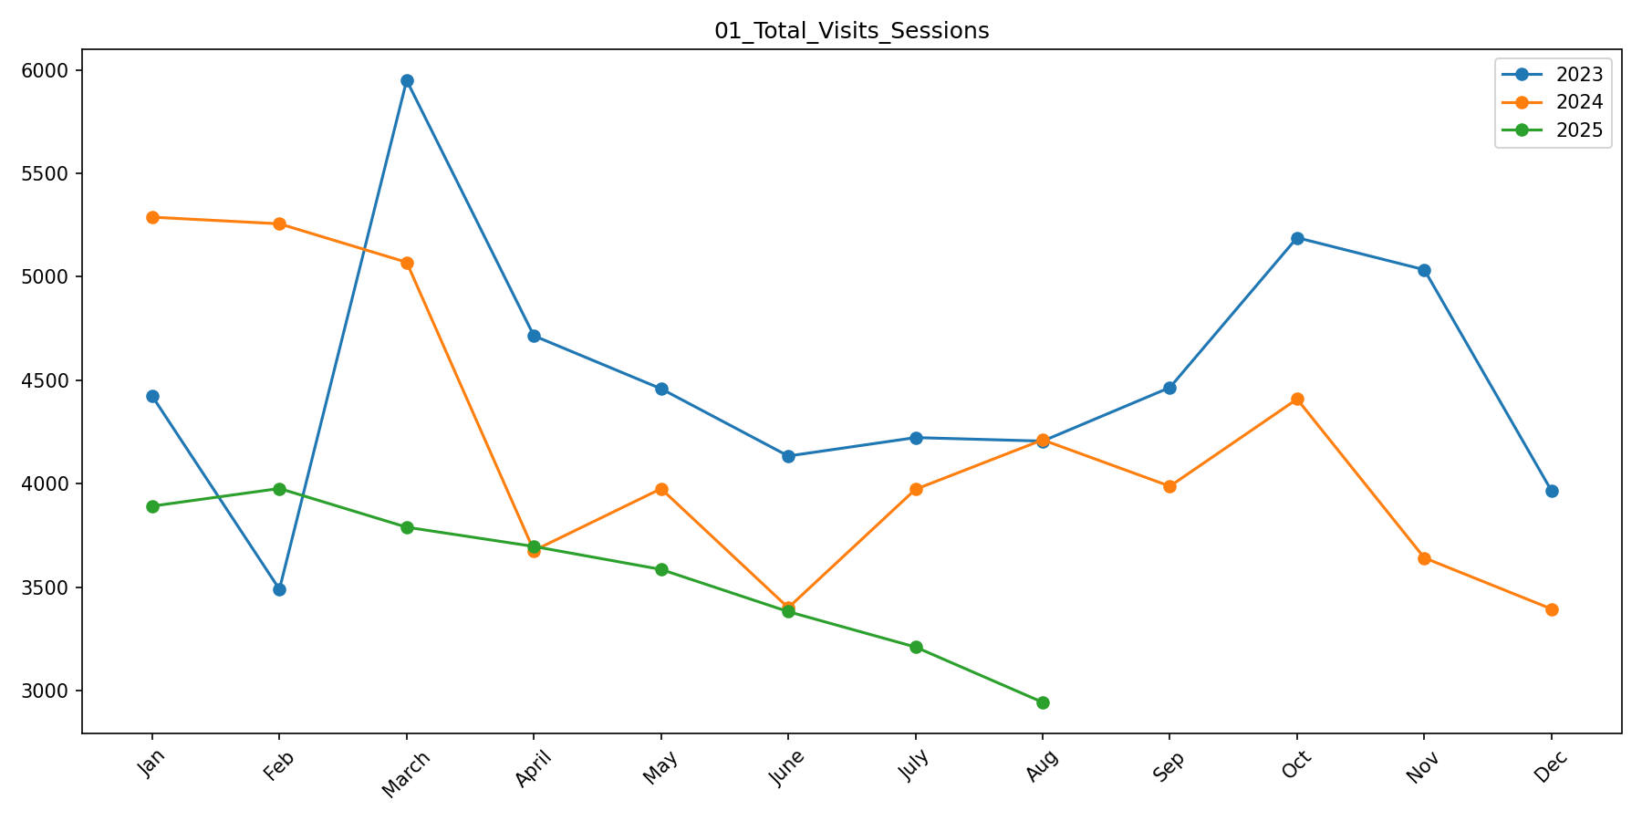
Graphs and Insights
Insight of Traffic_Visit_Sessions
### Overall Performance Insight
The overall traffic performance shows a **decline trend in 2024 compared to 2023**, with a **Year-over-Year change of -7.31%**.
This indicates that the platform has experienced a contraction in overall traffic levels over the year. The data suggests that performance shifts are not isolated to a single month but reflect a **broader annual movement**.
Month-over-Month variations observed throughout the year represent short-term fluctuations; however, the **primary business signal remains the overall yearly direction**, which should be the key focus for strategic decision-making.
### Management Perspective
- The current trend highlights the effectiveness of existing traffic acquisition and engagement strategies at an annual level.
- Sustaining and improving this trajectory will require reinforcing high-performing channels and addressing areas contributing to weaker periods.
- Continued monitoring of overall growth patterns is recommended to ensure long-term stability and scalability.
Graph 1: Traffic_Visit_Sessions

Slide 7
Challenges
GA4 API Access
No direct GA4 API access available
Real-time data could not be fetched
2. Data consistency across multiple tables

Slide 8
Future Enhancement
GA4 API integration for real-time data.
Channel-wise insights (Organic, Direct, Referral)
Automated PDF report generation

Slide 9
THANK YOU

